Slide 1

CNENGR506
Intelligent System Control

Slide 2






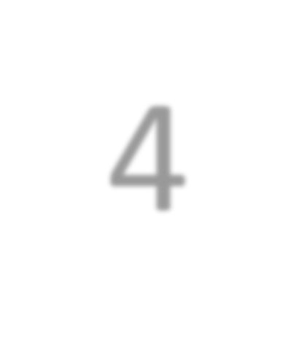
Syllabus
3
System
Identification
Concept of Feedback, Terminology and Objectives of Control
1
2
Optimal control
Introduction to “Modern Control”
Robust control
6
Transfer Functions represented using the
Theory
5
Backward Shift operator
State variable
Stochastic control
feedback using non-minimal state space models
pole assignment and 4
Block diagram analysis,
discrete-time PI control
Feed-forward control
CORE TOPIC
Multivariable & Non-linear

Slide 3
ENGR406 (506)
Intelligent System Control
Contents
Part 1 – Terminology and Objectives of Control
Part 2 – Discrete–Time Transfer Function Models
Part 3 – System Identification
Part 4 – Discrete–Time Control & Pole Assignment
Part 5 – State Variable Feedback
Part 6 – Additional Topics & Case Studies

Slide 4
Part 2 – Discrete–Time Transfer Function Models
Contents
Section 2.1 – Why Model?
Section 2.2 – Types of Model
Section 2.3 – Difference Equations
Section 2.4 – Backward Shift Operator
Section 2.5 – Steady state Gain
Section 2.6 – Poles and Stability
Section 2.7 – Block Diagrams

Slide 5
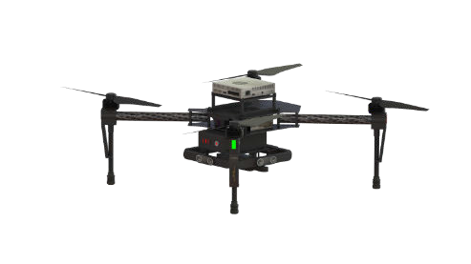
Cause and Effect
inputs
outputs
system

Slide 6
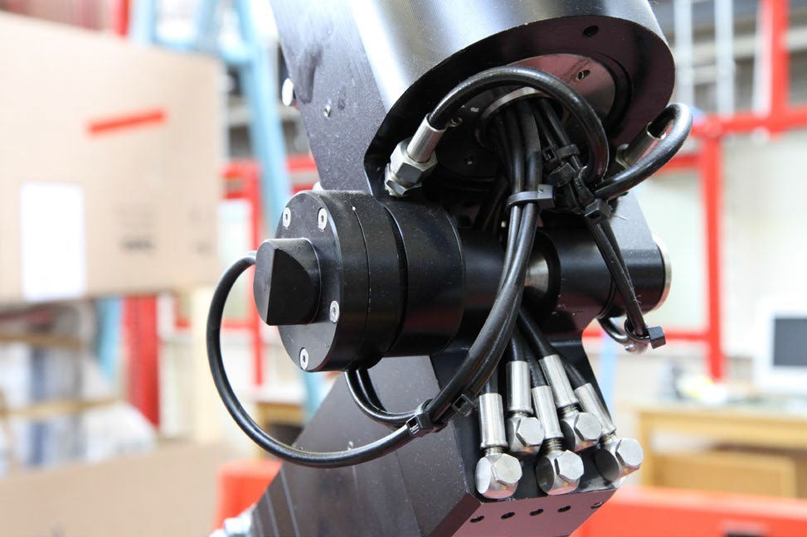
Single-Input, Single-Output
input
output
system

Slide 7
Illustrative Model
u_{k}
−1
−2
−3
y_{k}
b₁z + b₂ z
b₃ z
−1 −2
−3
input
1+ a₁z + a₂ z + a₃ z
output
discrete-time Transfer Function
(backward shift operator,
some people use z, q, B, etc.)

Slide 8
Numerical Example
u
y
k
27.4671z⁻¹ + 65.6418z⁻² − 91.1006z⁻³
k
1− 2.4425z⁻¹ + 2.2794z⁻² − 0.8274z⁻³
output
input
discrete-time Transfer Function

Slide 9
What is a Mathematical Model?
A scientific hypothesis about the behaviour of the system under study
Mathematical modelling is the process of describing a real world problem in mathematical terms, usually in the form of equations,
Why model?
Scientific understanding
Forecasting
Simulation
Management & Operational Planning
Optimisation
Control system design
Notes:
Mathematical modelling is the process of describing a real world problem in mathematical terms, usually in the form of equations,

Slide 10
The Scientific Method
Karl Popper (1959) … Scientific proof proceeds via
repeated exercises aimed at falsification
10

Slide 11

A priori data and information
Definition of Obje ctives
Planning stage
Speculative Bayesian
simulation modelling
Mode l structure formulation
Relevant data
colle ction
Mode l structure ide ntification
main iterative loop
Modelling Flow Chart
Parame ter estimation
Additional data
colle ction
Mode l falsification
exercises
Mode l conditionally
No
valid
Yes
Mode l acce ptable
Yes
No
Analyse nature of limitations
S ystems analysis and synthesis using
Yes
Mode l usable
No
11
the model: simulation, forecasting, operational control, management,
planning, optimisation

Slide 12
Lumped or distributed parameter model
Modelling Tree Diagram (1)
Linear model
Nonlinear model
Mechanistic model
Black box model
Grey box model
Continuous- time model
Discrete- time model
Deterministic
Stochastic

Slide 13
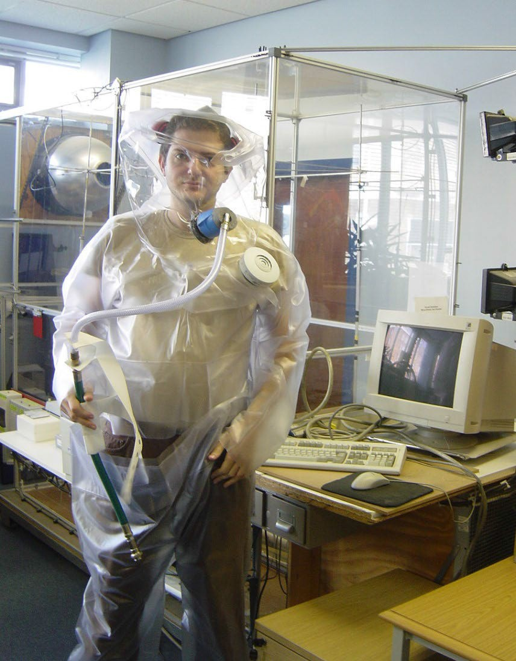
Ventilation Chamber

Slide 14
Main Airflow Patterns
Clockwise Rotation 250-300 m3/h
Anti-clockwise Rotation 80-220 m3/h
Intermediate Flow
~240 m3/h

Slide 15
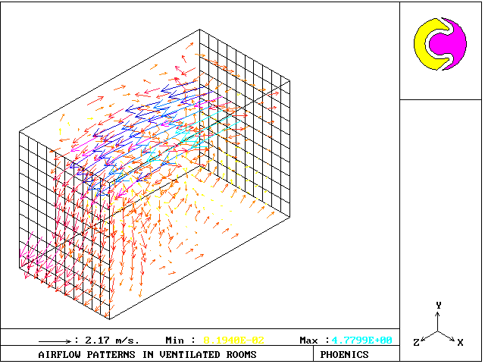
Computational Fluid Dynamics (PHOENICS)

Slide 16
Lumped or distributed parameter model
Modelling Tree Diagram (2)
Linear model
Nonlinear model
Mechanistic model
Black box model
Grey box model
Continuous- time model
Discrete- time model
Deterministic
Stochastic

Slide 17
Ventilation Rate Control for Different Operating Points
Ventilation Rate vs. Voltage
6000
5000
6000
Ventilation rate and set point
4000
4000
2000
m³/h
3000
0
0 50 100 150 200 250
2000
100
Control input
80
1000
60
40
0
0
10
20
30
40 50 60
percent
70
80
90
100
20
0
0 50 100
150 200 250
Time (s)

Slide 18
Lumped or distributed parameter model
Modelling Tree Diagram (3)
Linear model
Nonlinear model
Mechanistic model
Black box model
Grey box model
Continuous- time model
Discrete- time model
Deterministic
Stochastic

Slide 19
Lumped or distributed parameter model
Modelling Tree Diagram (3)
Linear model
Nonlinear model
Mechanistic model
Black box model
Grey box model
Continuous- time model
Discrete- time model
Deterministic
Stochastic

Slide 20
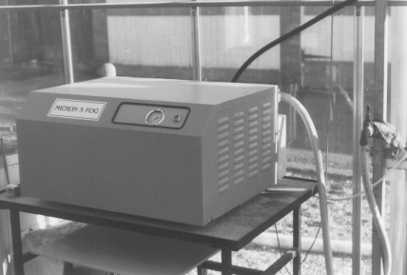
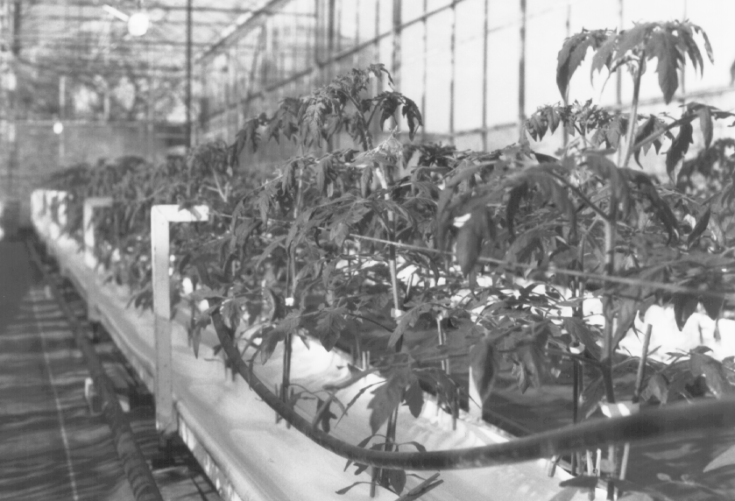
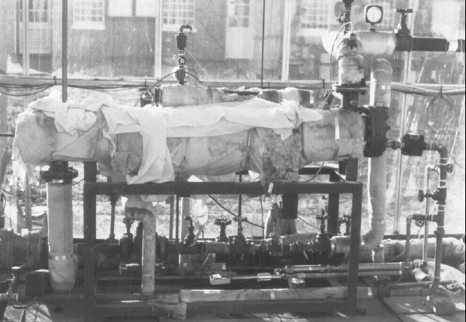
CO₂ supply pipe
Heating pipe
Glasshouse Actuators for Humidity, Temperature and Carbon Dioxide

Slide 21
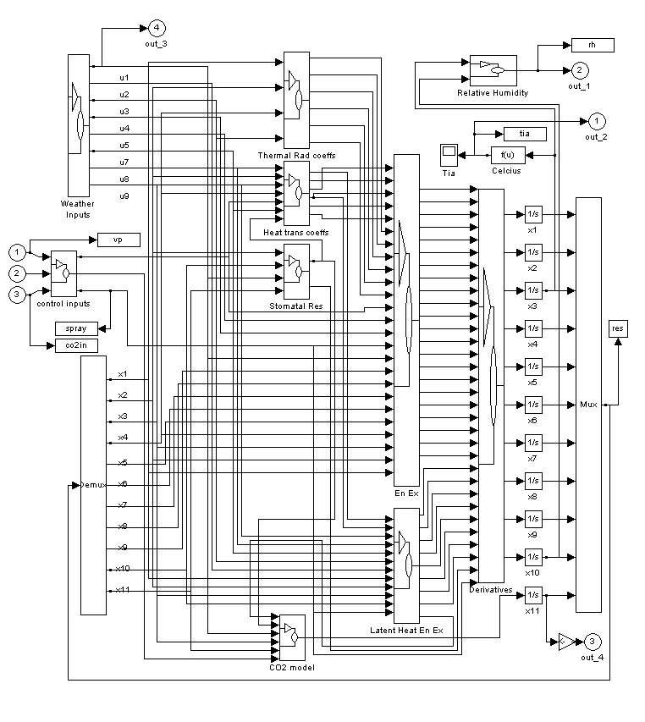
Glasshouse Model using Simulink

Slide 22
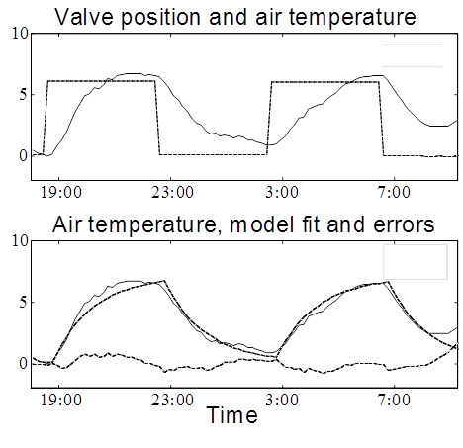
Open–Loop Experiment
Measured Data from a Venlo Glasshouse, Bedford, UK

Slide 23
Control Model for Temperature
0.65z⁻²
y(k ) = u(k )
1− 0.91z⁻¹

Slide 24
Mechanistic Models
Model represents the scientists prior perception of the system, based on an interpretation of ‘known’ physical laws. Prejudicial?
Characterised by parameters that have direct physical meaning, such as mass or electrical resistance
Data may be used to ‘validate’ the model
Simple mechanistic models can be used for control system design but these models are arguably more appropriate for simulation purposes

Slide 25
Data–Based Models
Obtained by direct reference to data.
These data are used to identify both the model structure and estimate the parameters using statistical analysis
The model is usually a black box relating the input and output variables in the simplest possible manner
Dominant mode model, ideal for control system design

Slide 26
Data–Based
Mechanistic (DBM) Models
Data are used to both identify the model structure and estimate the parameters using statistical analysis
But the DBM model only credible if it also is capable of interpretation in a physically meaningful manner
Contrasts with mechanistic models e.g. CFD
Also differs from ‘grey-box’ modelling

Slide 27
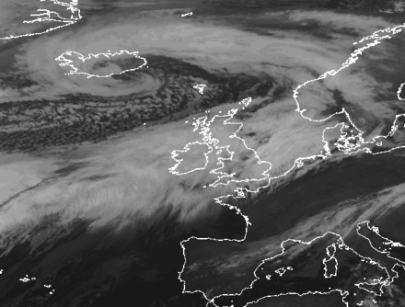

Derwent River Model
Effective Rainfall
Rainfall
River Flow
Nonlinear Element
Dynamic Model
https://commons.wikimed ia.org/wiki/File:Generic_U K_flood_image.jpg
http://www.nnvl.noaa.gov/view/#GOES

Slide 28
Dynamic Model
0.01706s² + 0.1578s + 0.001680
y(t) =
u(t)
s² + 0.3299s + 0.001768
Obtained by statistical estimation from the hourly measured flow and effective rainfall
y(t) is the river flow output
u(t) is the “effective rainfall” input
s is the differential operator, i.e. d/dt

Slide 29
Exercise
Lumped or distributed parameter model
Categorise the model on the previous slide (i.e. for the relationship between effective
Linear model
Nonlinear model
rainfall and river flow)
Mechanistic model
Black box model
Solution – in a moment
Continuous- time model
Discrete- time model

Slide 30
DBM Example
y(t) = ⎧0.0171+
0.1496
0.002573 ⎫_{u(t)}
+
s + 0.3244 s + 0.00545 ⎬
Applying partial fraction expansion, the river flow model can be written in parallel pathway form as above. This has the following practical interpretation:
An instantaneous effect accounting for the small amount of effective rainfall that affects the river flow within 1 hour
A ‘quick–flow’ effect with steady state gain and residence time or time constant (see later lecture) that is associated with surface and near surface processes
A ‘slow–flow’ effect with steady state gain and residence associated with groundwater processes

Slide 31
Lumped or distributed parameter model
Modelling Tree Diagram (4)
Nonlinear model
Grey box model
Linear model
Mechanistic model
Black box model
0.65z⁻²
Continuous- time model
Discrete- time model
y(k ) =
u(k )
1− 0.91z⁻¹
Also: analytical solution vs. numerical solution; steady state vs. fully dynamic or Monte Carlo, etc.
Deterministic
Stochastic

Slide 32
Part 2 – Discrete–Time Transfer Function Models
Contents
Section 2.1 – Why Model?
Section 2.2 – Types of Model
Section 2.3 – Difference Equations
Section 2.4 – Backward Shift Operator
Section 2.5 – Steady State Gain
Section 2.6 – Poles and Stability
Section 2.7 – Block Diagrams

Slide 33
Basic Notation
y
y(t)
y(0), y(Δt), y(2Δt) ☹ y(NΔt)
y(k −1)
^{y}k −1
y(k ) y(k +1)
^{y}k ^{y}k +1

Slide 34

Model for Vehicle Speed
We will develop a continuous-time, linear, mechanistic model for vehicle displacement and speed
Only for context and comparison with the discrete models used in this module!
y
y
y

Slide 35
Free Body Diagram
x is the velocity
u(t) − dy = my my + dy = u(t) mx + dx = u(t)
acceleration
y
velocity
y
displacement
y
by
m
u(t)

Slide 36
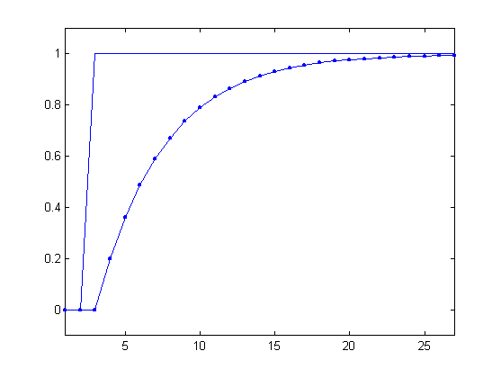
First Order, Continuous–Time
Differential Equation
^{m} x + x = ¹ u(t)
d d
See e.g. the analytical solution in response to a unit step input
Input
Output
x(t) = ¹ (1− e^{−d ⋅t m} )
time
d

Slide 37
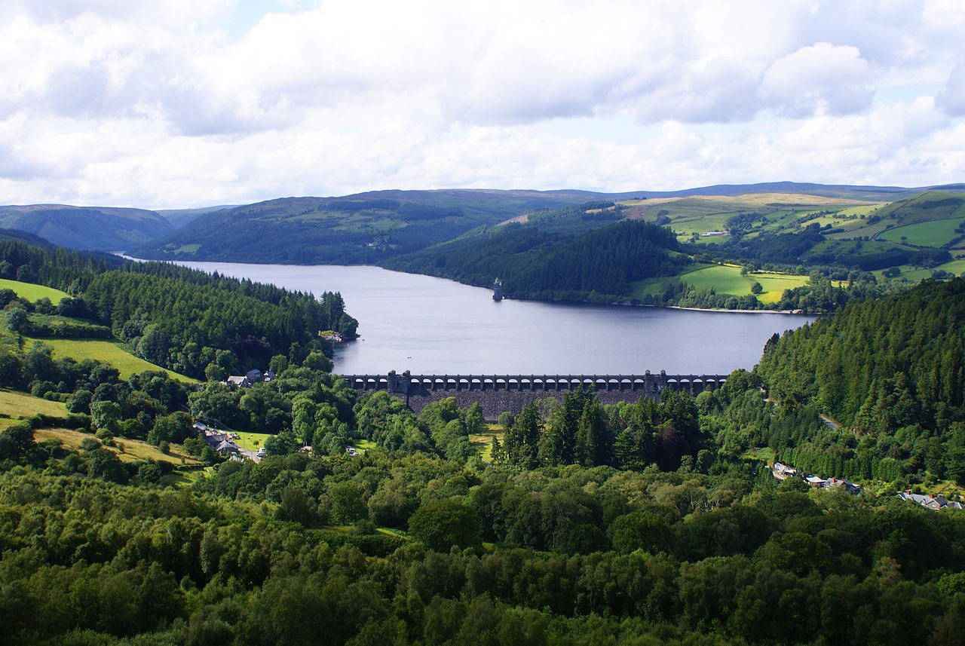
Reservoir Model
We will develop a discrete-time, linear, mechanistic model of a reservoir
Net inflow u(k)
Depth of water y(k)
https://en.wikipedia.org/wiki/Reservoir#/ media/File:Lakevyrnwysummer.jpg

Slide 38
Reservoir Model Mechanistic Development
V (k ) = V (k − 1) + I (k − 1) − O(k − 1) − αV (k − 1)
V (k ) = A ⋅ y(k )
u(k ) = I (k ) − O(k )
Ay(k ) = Ay(k −1) + u(k −1) − α Ay(k −1)
y(k ) = −ay(k − 1) + bu(k − 1)
(Exercise: show that b = 1 A, a = α −1)

Slide 39
First Order, Discrete-Time
Difference Equation
In this module, this is important notation
y(k ) = −ay(k − 1) + bu(k − 1)
Later, we will introduce more than just two parameters, hence could use subscripts
y(k ) = −a₁ y(k −1) + b₁u(k −1)

Slide 40
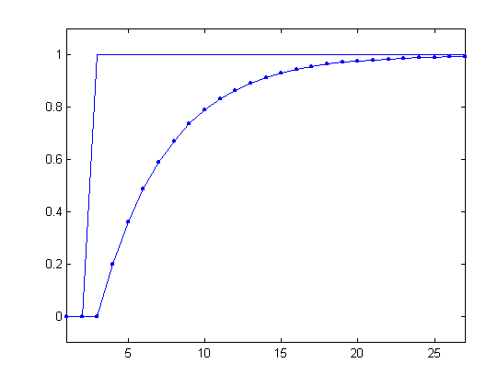
Reservoir Model Step Response (1)
u(k > 2) = 1 otherwise zero
u(0) = 0, u(1) = 0, u(2) = 0, u(3) = 1, u(4) = 1, 😐
b = 0.2
a = −0.8
y(0) = 0
Input
y(k) = 0.8 y(k −1) + 0.2u(k −1)
y(1) = 0
y(2) = 0
Output

Slide 41
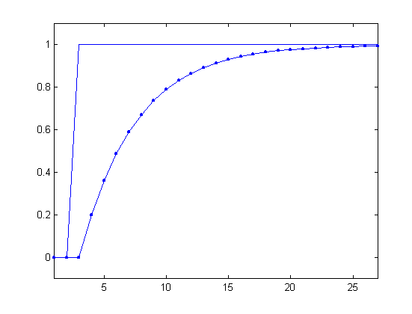
Reservoir Model
Step Response (2)
y(k) = 0.8 y(k −1) + 0.2u(k −1)
u(2) = 0, u(3) = 1, u(4) = 1,😐
y(0) = y(1) = y(2) = 0
y(3) = 0.8(0) + 0.2 (0) = 0
y(4) = 0.8(0) + 0.2 (1) = 0.2 y(5) = 0.8(0.2) + 0.2 (1) = 0.36
y(6) = 0.8(0.36) + 0.2 (1) = 0.49
y(7) = 0.8(0.49) + 0.2 (1) = 0.59

Slide 42
Reservoir Model
Step Response (Table)
k | u(k ) | u(k −1) | y(k)
2 | 0 | 0 | 0
3 | 1 | 0 | 0
4 | 1 | 1 | 0.2
5 | 1 | 1 | 0.36
6 | 1 | 1 | 0.49
7 | 1 | 1 | 0.59
y(3) = 0.8(0) + 0.2 (0) = 0 y(4) = 0.8(0) + 0.2 (1) = 0.2 y(5) = 0.8(0.2) + 0.2 (1) = 0.36
y(6) = 0.8(0.36) + 0.2 (1) = 0.49
y(7) = 0.8(0.49) + 0.2 (1) = 0.59

Slide 43
Laboratory Axial Fan in Ventilation Chamber
A discrete-time, linear, data-based model will be presented
Parameter values have already been estimated by the lecturer (from data)
Hence, this example is again about how to use the model e.g. to examine the step response

Slide 44
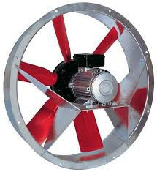
Axial Fan Block Diagram
u(k )
voltage
y(k )
airflow

Slide 45
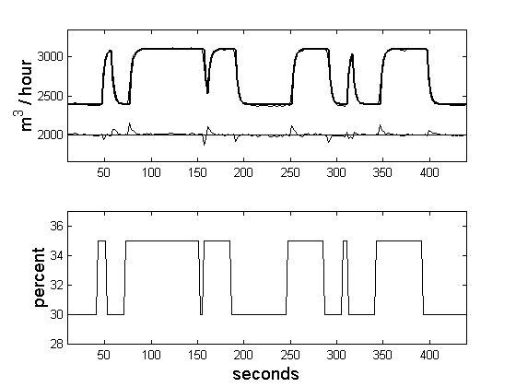
Open–Loop Experimental Data (and Model Response)

Slide 46
Axial Fan Model
u(k )
y(k )
voltage
airflow
y(k) = −a₁ y(k −1) + b₁u(k −1)
y(k) = 0.8 y(k −1) +1.6u(k −1)

Slide 47
Step Response of the Axial Fan Model
y(k) = 0.8(0) +1.6(1) = 1.6
y(k) = 0.8(1.6) +1.6(1) = 2.88
y(k) = 0.8(2.88) +1.6(1) = 3.90
y(k) = 0.8 y(k −1) +1.6u(k −1)
k u(k ) u(k −1) y(k)
4 0 0
0
5
1 0
0
6
output
6
1
1
1.6
4
7
1
1
2.88
2
control input
8
1
1
3.90
0
9
1
1
4.72
0
10
20
30
40
50
sample no.

Slide 48
Response using the Experimental Data
Compare model with data i.e. simulate from initial conditions as above
Becomes tedious to solve by hand!
Use MATLAB function filter
Or can use SIMULINK filter

Slide 49
Part 2 – Discrete–Time Transfer Function Models
Contents
Section 2.1 – Why Model?
Section 2.2 – Types of Model
Section 2.3 – Difference Equations
Section 2.4 – Backward Shift Operator
Section 2.5 – Steady State Gain
Section 2.6 – Poles and Stability
Section 2.7 – Block Diagrams

Slide 50
Backward Shift Operator
y
y
k
_{z}−1
k −1
z
−1
^{y}k ^{= y}k −1
z
−2
^{y}k ^{= y}k −2

Slide 51
Discrete-Time Transfer Function (First Order Example)
^{y}k ^{= −a}1 ^{y}k −1 ^{+ b}1^{u}k −1
^{y}k ^{+ a}1 ^{y}k −1 ^{= b}1^{u}k −1
Difference Equation
y_{k} + a₁z⁻¹ y_{k} = b₁z⁻¹u_{k}
(1+ a₁z⁻¹ ) y_{k} = b₁z⁻¹u_{k}
_{b z}−1
Transfer Function
y_{k} =
1
u_{k}
1+ a₁z
−1

Slide 52
Discrete-Time Transfer Function (Block Diagram)
b₁z
−1
y =
u
k
−1
k
1+ a₁z
u_{k}
b₁z
−1
y_{k}
1+ a₁z
−1

Slide 53
Discrete-Time Transfer Function (Reservoir Model)
u_{k}
0.2z⁻¹
y_{k}
1− 0.8z⁻¹

Slide 54
Discrete-Time Transfer Function (Axial Fan Model)
u_{k}
1.6z⁻¹
y_{k}
1− 0.8z⁻¹

Slide 55
Discrete-Time Transfer Function (Reverse)
b₁z
−1
y =
u
Transfer Function
k
−1
k
1+ a₁z
(1+ a₁z⁻¹ ) y_{k} = b₁z⁻¹u_{k}
y_{k} = −a₁z⁻¹ y_{k} + b₁z⁻¹u_{k}
Difference Equation
^{y}k ^{= −a}1 ^{y}k −1 ^{+ b}1^{u}k −1

Slide 56
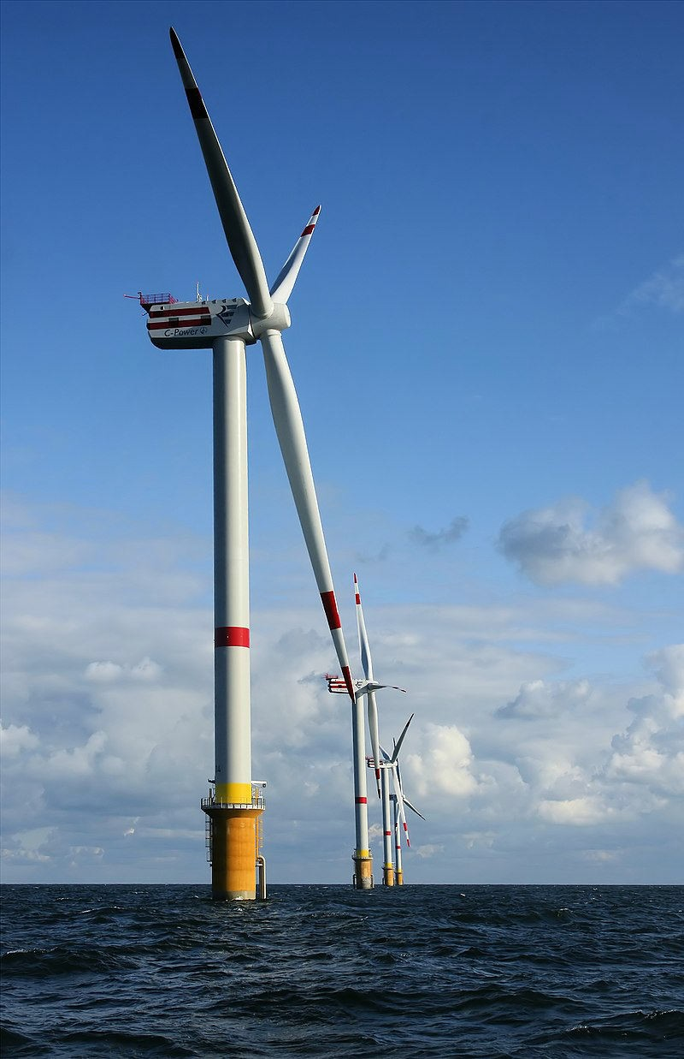
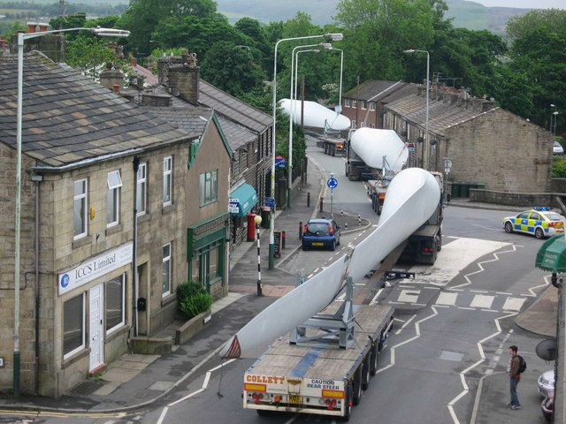
Model for a Wind Turbine
https://en.wikipedia.org/wiki/Wind_turbine#/media/File:Turbin e_Blade_Convoy_Passing_through_Edenfield.jpg
https://en.wikipedia.org/wiki/Wind_turbine#/ media/File:Windmills_D1- D4_(Thornton_Bank).jpg

Slide 57
Open-Loop Simulation Data
Poorly damped
Generator reaction torque y(k)
Pitch angle u(k)
Aim to keep the turbine components within designed speed and torque limits
output
600
400
y_{k}
200
0
0
20
40
60
80
100
input
1
0.5
u
k
0
0
20
40
60
80
100
sample no.

Slide 58
Third Order Model
^{y}k ^{= −a}1 ^{y}k −1 ^{− a}2 ^{y}k −2 ^{− a}3 ^{y}k −3 ^{+ b}0^{u}k ^{+ b}1^{u}k −1 ^{+ b}2^{u}k −2
y_{k} = −a₁z⁻¹ y_{k} − a₂ z⁻² y_{k} − a₃ z⁻³ y_{k} + b₀u_{k} + b₁z⁻¹u_{k} + b₂ z⁻²u_{k}
(1+ a₁z⁻¹ + a₂ z⁻² + a₃ z⁻³ ) y_{k} = (b₀ + b₁z⁻¹ + b₂ z⁻² )u_{k}
u_{k}
b₀ + b₁z
−1
b₂ z
−2
y_{k}
1+ a₁z
−1
a₂ z
−2
a₃ z
−3

Slide 59
Time Delays
600
400
y_{k}
200
0
0
5
10
15
1.5
1
u_{k}
0.5
0
0
5
10
15
https://en.wikipedia.org/wiki/Wind_turbine#/ media/File:Windmills_D1- D4_(Thornton_Bank).jpg

Slide 60
Wind Turbine with Time Delay
^{y}k ^{= −a}1 ^{y}k −1 ^{− a}2 ^{y}k −2 ^{− a}3 ^{y}k −3 ^{+ b}3^{u}k −3 ^{+ b}4^{u}k −4 ^{+ b}5^{u}k −5
y_{k} = −a₁z⁻¹ y_{k} − a₂ z⁻² y_{k} − a₃ z⁻³ y_{k} + b₃ z⁻³u_{k} + b₄ z⁻⁴u_{k} + b₅ z⁻⁵u_{k}
time delay
b₀ = b₁ = b₂ = 0
u_{k}
−3
−4
−5
y_{k}
b₃ z + b₄ z
b₅ z
1+ a₁z
−1
a₂ z
−2
a₃ z
−3

Slide 61
Generalised Discrete-Time Transfer Function Model
b₀ + b₁z
−1
+☹+ b_{m} z
−m
−1
₌ B( z ) _{u}
y =
u
k
1+ a₁z
−1
a₂ z
−2
+☹+ a_{n}z
−n
k
−1
k
A(z )
u_{k}
B(z⁻¹)
y_{k}
A(z⁻¹)
n is the order of the system
Minimal state space models have n states – see later

Slide 62
Unity Time Delay Version
−1
−m
−1
b₁z +☹+ b_{m} z
₌ B( z ) _{u}
y =
u
k
1+ a₁z
−1
a₂ z
−2
+☹+ a_{n}z
−n
k
−1
k
A(z )
u_{k}
B(z⁻¹)
y_{k}
A(z⁻¹)
The model we will use later for control system
design has at least 1 sample time delay, hence b₀ = 0

Slide 63
Part 2 – Discrete–Time Transfer Function Models
Contents
Section 2.1 – Why Model?
Section 2.2 – Types of Model
Section 2.3 – Difference Equations
Section 2.4 – Backward Shift Operator
Section 2.5 – Steady State Gain
Section 2.6 – Poles and Stability
Section 2.7 – Block Diagrams

Slide 64
Steady State Gain
y(k ) − y(k −1) = 0
y(k )(1− z⁻¹ ) = 0
z⁻¹ = 1
The gain tells us the magnitude of the output relative to the input at steady state
To find the steady state gain of a discrete-time Transfer Function, set the backward shift operator to unity
To find the steady state value of the output, multiply the gain by the value of the input

Slide 65
Steady State Gain (General Transfer Function Model)
⎛
y(k → ∞) =
b₁ + b₂ +☹+ b_{m}
⎞
u = G u
⎜ ⎟
0
0
⎝ 1+ a₁ + a₂ +☹+ a_{n ⎠}
This slide shows the steady state gain of the generalised Transfer Function model i.e. G
It also shows that the output asymptotically approaches a value of G multiplied by u₀, where u₀ is a constant input (in the case of a unit step response, u₀ = 1)

Slide 66
Steady State Gain (Axial Fan)
u_{k}
1.6z⁻¹
y_{k}
1− 0.8z⁻¹
u
y(k → ∞)
0
8

Slide 67
Step Response (Axial Fan)
8
6
output
4
2
control input
0
0
10
20
30
40
50
sample no.

Slide 68
Steady State Gain (Reservoir Model)
u_{k}
0.2z⁻¹
y_{k}
1− 0.8z⁻¹
u
y(k → ∞)
0
1

Slide 69
Wind Turbine Model
u
y
k
27.4671z⁻¹ + 65.6418z⁻² − 91.1006z⁻³
k
1− 2.4425z⁻¹ + 2.2794z⁻² − 0.8274z⁻³
output
input
discrete-time Transfer Function

Slide 70
Backward Shift Operator Set to Unity
u₀
y(k → ∞)
27.4671+ 65.6418 − 91.1006
input
1− 2.4425 + 2.2794 − 0.8274
output
steady state gain

Slide 71
Steady State Gain for the Wind Turbine Model
u₀
y(k → ∞)
211.4
input
output
steady state gain

Slide 72
Step Response (Wind Turbine)
output
600
400
200
0
0
20
40
60
80
100
input
1
0.5
0
0
20
40
60
80
100
sample no.

Slide 73
Time Constant
The continuous–time concept of a time constant is referred to occasionally in this module.
It relates to the analytical solution for the unit step response of a first order differential equation
It is the time taken for the output to reach 63% of the steady state value

Slide 74
Time Constant
for Reservoir Model
b₁z
−1
Δt
y =
u
T = −
k
−1
k
1+ a₁z
log_{e} (−a₁ )
e.g. Reservoir model with 1 hour sampling rate
0.2z⁻¹
1
y_{k} = ₋₁ u_{k}
1− 0.8z
T = − = 4.5 hours
log (0.8)
e

Slide 75

Unit Step Response for Reservoir Model
For this model, there is a one sample time delay and the steady state gain is 1.0
The output reaches 0.63 m (water depth) 4.5 hours after the “start” of the step response
Can be used to represent the speed of response
4.5 hours

Slide 76

Part 2 – Discrete–Time Transfer Function Models
Contents
Section 2.1 – Why Model?
Section 2.2 – Types of Model
Section 2.3 – Difference Equations
Section 2.4 – Backward Shift Operator
Section 2.5 – Steady state Gain
Section 2.6 – Poles and Stability
Section 2.7 – Block Diagrams

Slide 77
Stable System
Generator Reaction Torque
600
“If a system that is initially in equilibrium is disturbed, it is said to be stable if it eventually returns to an equilibrium condition”
500
400
300
200
100
0
-100
0
5
10 15
Time (seconds)
20
25

Slide 78
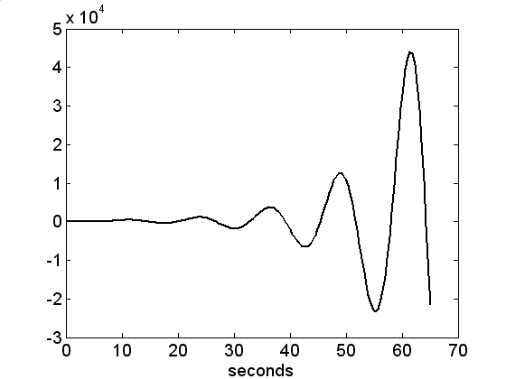
Unstable System
2.5
10 ⁴
2
1.5
Output
1
0.5
0
3
4
5
6
7
8
9
10
Time

Slide 79
Step Response of the Axial Fan Model
stability
y(k) = 0.8 y(k −1)
y(k) = 0.8 y(k −1) +1.6u(k −1)
k | u(k ) | u(k −1) | y(k)
4 | 0 | 0 | 0
5 | 1 | 0 | 0
6 | 1 | 1 | 1.6
7 | 1 | 1 | 2.88
8 | 1 | 1 | 3.90
9 | 1 | 1 | 4.72
8
6
output
4
2
control input
0
0
10
20
30
40
50
sample no.

Slide 80
Stability of the First Order Model
y(k) = 0.8 y(k −1) +1.6u(k −1)
1.6z⁻¹
y(k) = −a y(k −1) + b u(k −1)
y(k ) = u(k ) 1− 0.8z⁻¹
1
1
−1
b₁z
y(k) =
u(k )
1+ a₁z
−1
From the previous slide, we see that, for stability, negative a₁ (which takes the value 0.8 for the fan model) should be less than 1.0. Negative a₁ is called the pole.

Slide 81
Backward and Forward Shift Operators
z⁻¹ y(k ) = y(k −1)
zy(k ) = y(k +1)
Standard rules of algebra apply!
_{z}−1 ₌ ¹
z
z⁻¹z = 1
Etc.
_{z}−5 _{z}2 _{= z}−3

Slide 82
Fan Model
Pole and Stability
1.6z⁻¹
y(k ) = u(k ) 1− 0.8z⁻¹
TF model
1− 0.8z⁻¹
TF denominator – characteristic polynomial
1− 0.8z⁻¹ = 0
Characteristic equation
z − 0.8 = 0
Convert to z domain
z = 0.8
Pole, less than 1.0, hence the model is “Stable”

Slide 83
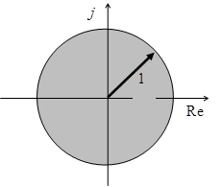
Poles and Stability
1+ a₁z
−1
a₂ z
−2
−n
+☹+ a_{n}z = 0
z^{n} + a₁z^{n−1} + a₂ z^{n−2} +☹+ a_{n} = 0
Solve for z – the roots of this equation are called the poles p_{i} and for stability:
p_{i}
< 1
i = 1, 2, 😐, n

Slide 84
Comments
Roots of the characteristic equation are called the poles
We use the forward shift (not backward shift) to examine the stability, so that poles inside the unit circle imply stability
Poles might be real or complex conjugate pairs, or a mixture of both
Complex poles imply the system might oscillate
If there are no complex poles, the response will be
exponential (stable or unstable)

Slide 85
Wind Turbine Model
1− 2.4425z⁻¹ + 2.2794z⁻² − 0.8274z⁻³ = 0
z³ − 2.4425z² + 2.2794z − 0.8274=0
>> roots([1 -2.4425, 2.2794, -0.8274])
ans =
0.9751
0.7337 + 0.5570i
0.7337 - 0.5570i
>> abs(ans) ans =
0.9751
0.9212
0.9212

Slide 86
General Discrete-Time Transfer Function Model
b₀ + b₁z
−1
+☹+ b_{m} z
−m
−1
₌ B( z ) _{u}
y =
u
k
1+ a₁z
−1
a₂ z
−2
+☹+ a_{n}z
−n
k
−1
k
A(z )
u_{k}
B(z⁻¹)
y_{k}
A(z⁻¹)

Slide 87
Illustrative Model Responses
0.4 | stable system
0.2
0
0 | 10 20 | 30 | 40 | 50
0.4
0.2
0
-0.2
stable, non-minimum phase system
0
10 20 30
marginally stable system
40
50
10
5
0
0
10
20
30
40
50
sample no.

Slide 88
Part 2 – Discrete–Time Transfer Function Models
Contents
Section 2.1 – Why Model?
Section 2.2 – Types of Model
Section 2.3 – Difference Equations
Section 2.4 – Backward Shift Operator
Section 2.5 – Steady state Gain
Section 2.6 – Poles and Stability
Section 2.7 – Block Diagrams

Slide 89
Block Diagram Analysis
Earlier videos concerned the analysis of a single Transfer Function in isolation
In control system design scenarios, we may have several linked Transfer Functions representing, for example, the model and the control algorithm
Block diagram analysis is a straightforward way of combining several Transfer Functions into one “overall”
Transfer Function, ready for further analysis
(e.g. stability of a control system)

Slide 90
Single Transfer Function (or Scalar Gain)
x₁(k )
x₂ (k )
G₁
x₂ (k) = G₁x₁(k)

Slide 91
Series Rule
x₁(k )
x₂ (k )
x₃ (k )
G₁
G₂
x₃ (k ) = G₂ x₂ (k ) = G₂ (G₁ ⋅ x₁(k )) = G₂G₁x₁(k ) = G₁G₂ x₁(k )
x₁(k )
x₃ (k )
G₁G₂

Slide 92
Series Rule showing Numerator and Denominator
x₁(k )
C(z⁻¹)
x₂ (k)
B(z⁻¹)
x₃ (k )
D(z⁻¹)
A(z⁻¹)
x₁(k )
C(z⁻¹)B(z⁻¹)
x₃ (k )
D(z⁻¹) A(z⁻¹)

Slide 93
Negative Feedback Rule
x₁(k ) ₊
x₂ (k)
G₁
−
G₁
x (k ) =
x (k )
G₂
2
1+ G G
1
1 2
x₂ (k) = G₁ ( x₁(k) − G₂ x₂ (k ))

Slide 94
Negative Feedback Rule Example (Original Diagram)
r(k ) ₊
y(k )
B(z⁻¹)
A(z⁻¹)
−
C(z⁻¹)
D(z⁻¹)

Slide 95
Negative Feedback Rule Example (Reduced Form)
⎛ B(z⁻¹) ⎞
r(k )
⎜
⎟
⎜
−1
⎟
y(k )
A(z )
⎝ ⎠
⎛ C(z⁻¹) ⎞⎛ B(z⁻¹) ⎞
1+
⎜
⎟ ⎜
⎟
⎜
−1
⎟⎜
−1
⎟
⎝
D(z )
⎠⎝
A(z )
⎠
r(k )
B(z⁻¹)D(z⁻¹)
y(k )
D(z⁻¹) A(z⁻¹) + C(z⁻¹)B(z⁻¹)

Slide 96
Footnote –
High Gain Control
r
y
+
k
G
−
k G
y = r
1+ k G
Consider what if k G >> 1
then y = r

Slide 97
Conclusions
This section has considered:
– Why Model?
– Types of Model
– Difference Equations
– Backward Shift Operator
– Steady state Gain
– Poles and Stability
– Block Diagrams

